Slide 1
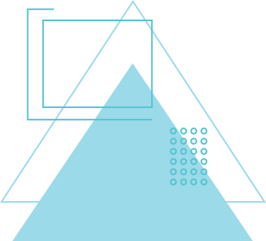
DATA COLLECTION, CLEANING, VISUALIZATION, AND ANALYSIS

Slide 2
WHY DATA CLEANING?
Raw Data is very mess. It consist messy data like typos, empty values, duplicate values and various weird stuff.
So it is important to clean this type of data and make data nice so you can apply what you want do on that data.

Slide 3
HOW WE ACTUALLY FIX THE DATA
When we get data it have mistakes that we have to fix manually. In this data there is many empty values and we have to decide in that if we have to delete that entire row or we have to fill that with average number so we don’t lose that row. and we have to also check the name of values are same like “IND” and “India” are all changed with only one name so computer doesn’t think they are different countries. and we also check for impossible values like someone accidently put their age -25 and 200 and we have to either fix them or delete them so they don’t mess with our math

Slide 4



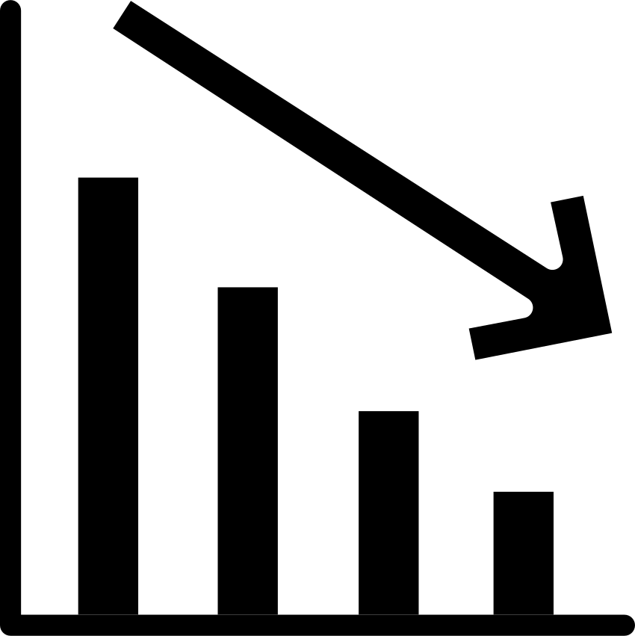
WHY WE TURN DATA INTO PICTURES
Once the data is clean we convert that data to charts or in visual format because looking spreadsheet of that large data is impossible for human brain to understand that data. convert that data into colors and shape will help us understand that data easily like sales going up every january. so it is useful when data is in chart rather than giant table format.

Slide 5
PICKING THE BEST CHART FOR THE JOB
After you clean the data you can’t just make any random chart, you have to think before choosing the chart like if you want show how something is changing over a period of time then you must choose line chart . But if you just want to check or compare two groups like which flavor of soda is most popular then you have to plot bar chart that can give you what you want. So this is very important to select correct chart if you choose wrong chart it maybe give you wrong information or confusing for users to uderstand that chart.

Slide 6
MAKING YOUR CHARTS EASY TO READ
A good chart should be simple and easy for user eyes to understand the data. You should not use 20 colors or add bunch of extra decoration like 3D effects that distract user from the actual info.
The most important thing to add clear X and Y label to your chart and also add appropriate title to your chart that helps the user to understand what kind of data they are looking.

Slide 7
THANK YOU
By Aryan

